Slide 1
Winter Research on HCTSA
Haohua Li
July 2020

Slide 2
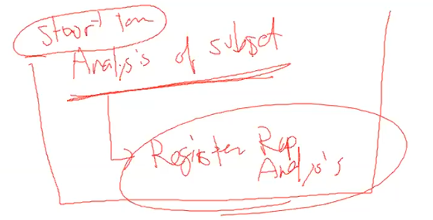
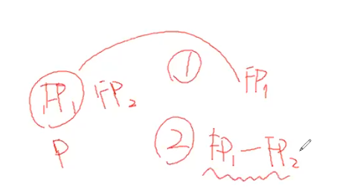
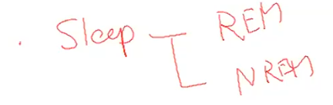
Plan

Slide 3

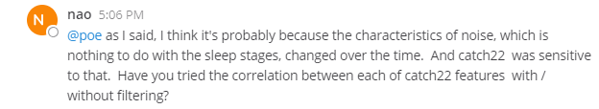
To-Do List (old)

Slide 4
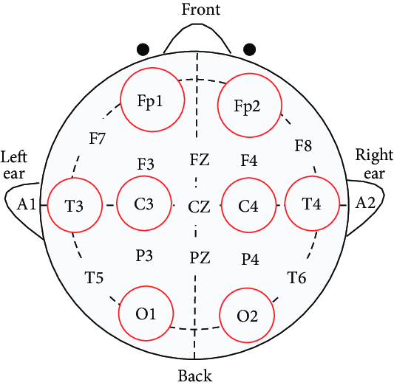
Sleep Headband Dataset
Sleep headband ZMax
Sampling rate 256 Hz
Time = no. of samples / sampling rate
7-hours data recorded
Two channels closed to FP1 (called EEG L) and FP2 (called EEG R) respectively.
Simultaneous data acquired from gold standard (SOMNOScreen)
In order to analyze the headband data in a blind manner, the gold standard data is not provided.
HCTSA v1.03 and catch22
Left
Right
https://www.researchgate.net/figure/EEG-electrodes-location-of-international-10-20-system_fig11_283553087
Notes:
Analyze EEG with HCTSA https://github.com/benfulcher/hctsaTutorial_BonnEEG

Slide 5
Hypothesis
EEG can be used to sleep scoring.
Assume EEG reflects the depth of sleep.

Slide 6
Epoching
How do expertists score human sleep?
30s epoch
10s epoch
Some papers [citation?] have mentioned that the traditional epoching method may miss the continuities in the development of sleep ????

Slide 7
Raw Data
Dataset: 2 subjects, 2 nights, 2 channels

Slide 8
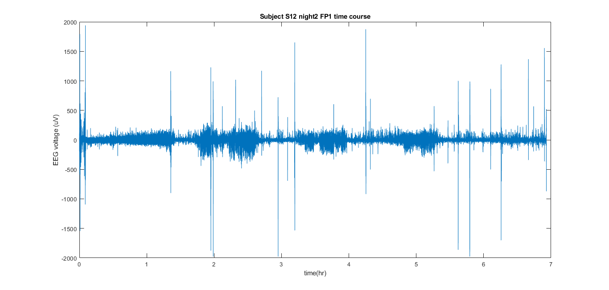
Data - time course
Subject : Raw, S12, night2, FP1

Slide 9
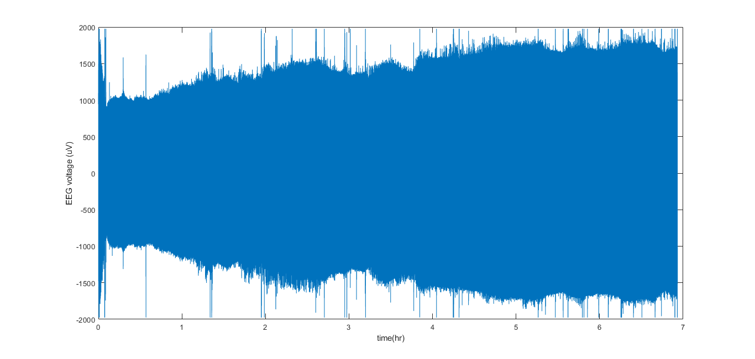
Data - time course
Subject : Raw, S12, night2, FP1

Slide 10
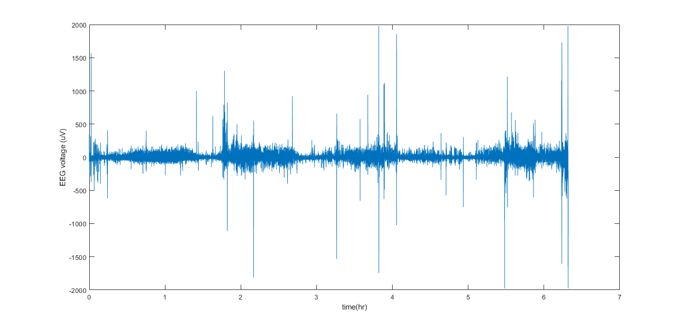
Data - time course
Subject : Raw, S12, night2, FP1

Slide 11
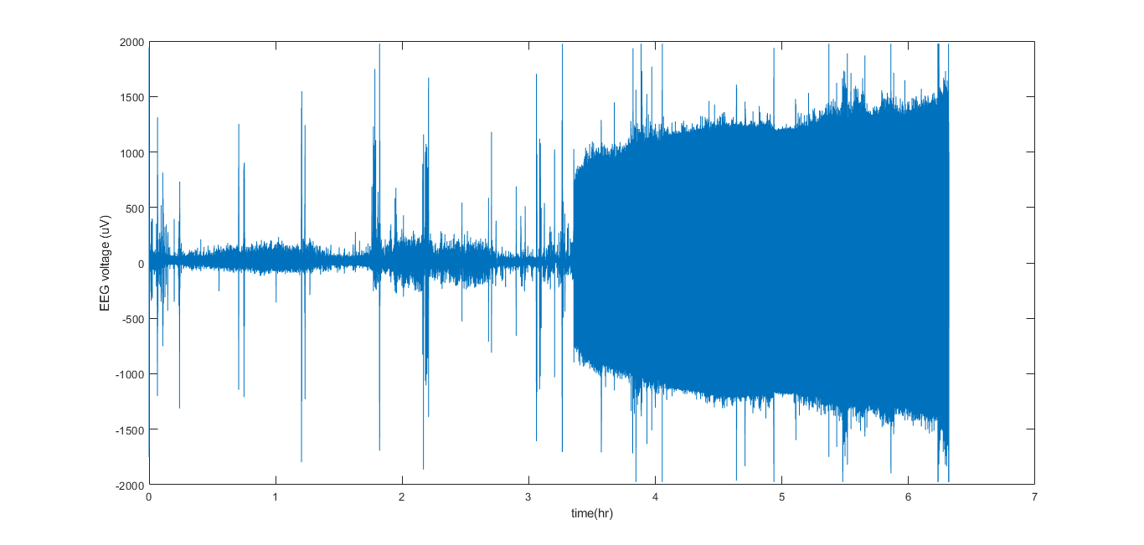
Data - time course
Subject : Raw, S12, night2, FP1

Slide 12
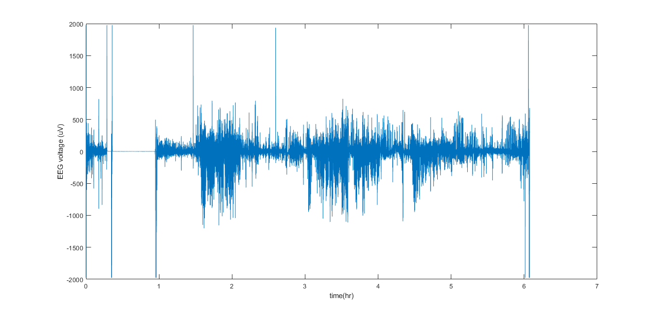
Data - time course
Subject : Raw, S12, night2, FP1

Slide 13
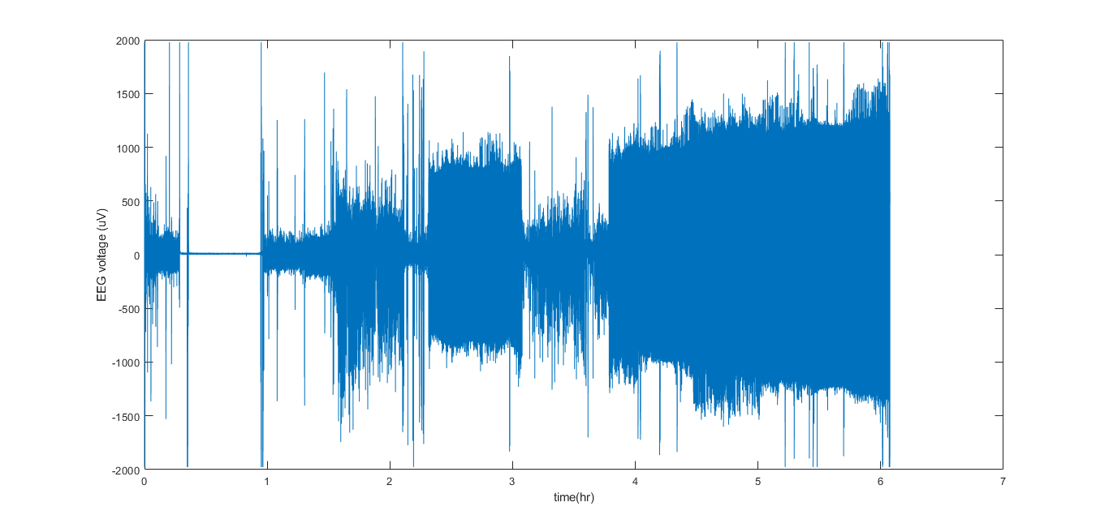
Data - time course
Subject : Raw, S12, night2, FP1

Slide 14
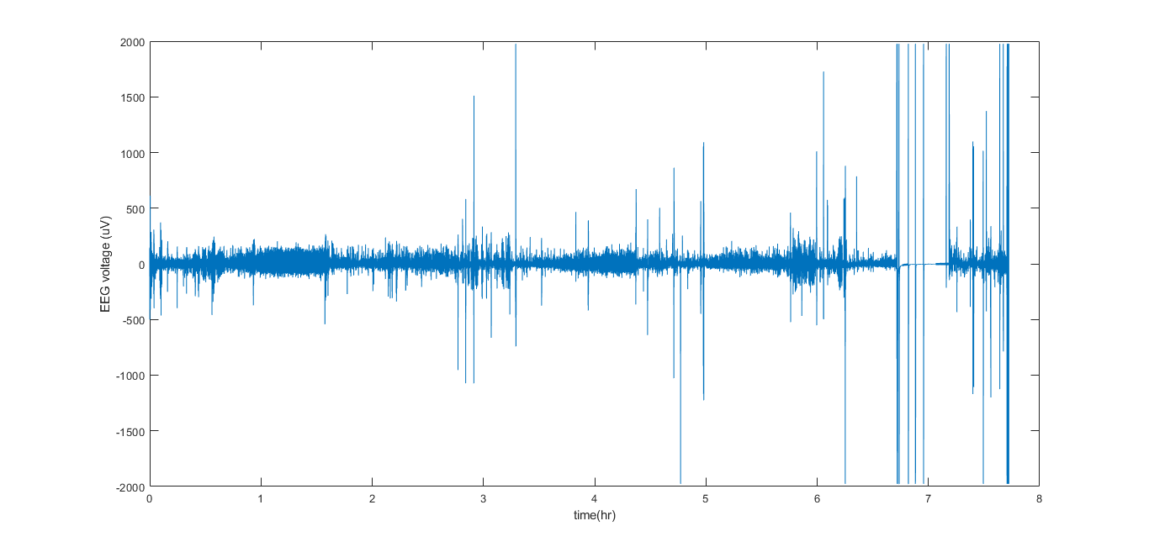
Data - time course
Subject : Raw, S12, night2, FP1

Slide 15
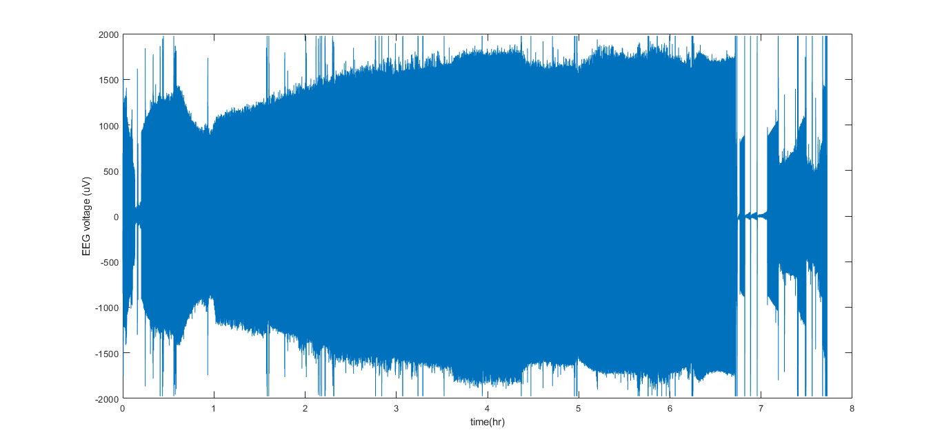
Data - time course
Subject : Raw, S12, night2, FP1

Slide 16
Potential Issues in FP2 (EEG R) Channel
https://docs.google.com/presentation/d/1rMd4SzccQc8PlGVNcz-GlqmtafKkIvLPm_ZpYrsIAMs/edit?usp=sharing

Slide 17
Channel FP1 Analysis
Subject : Raw, S12, night2, FP1

Slide 18
Data - time course, night 2, FP1
Subject : Raw, S12, night2, FP1

Slide 19
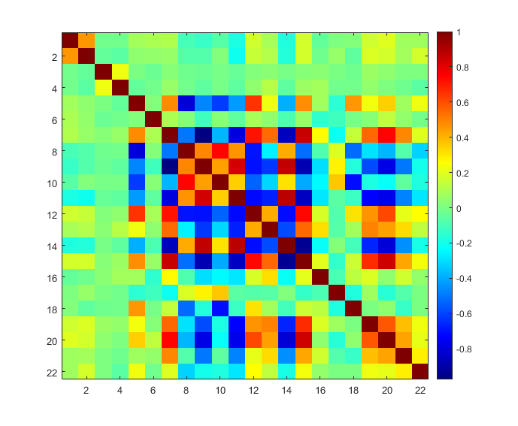
Correlation between catch22 features

Slide 20
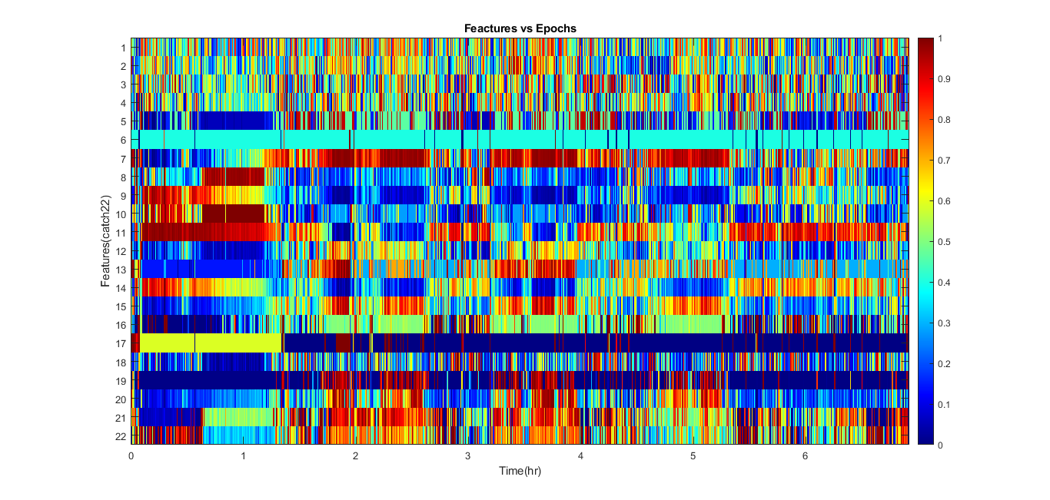

Epochs vs Features
Subject : Raw, S12, night2, FP1

Slide 21
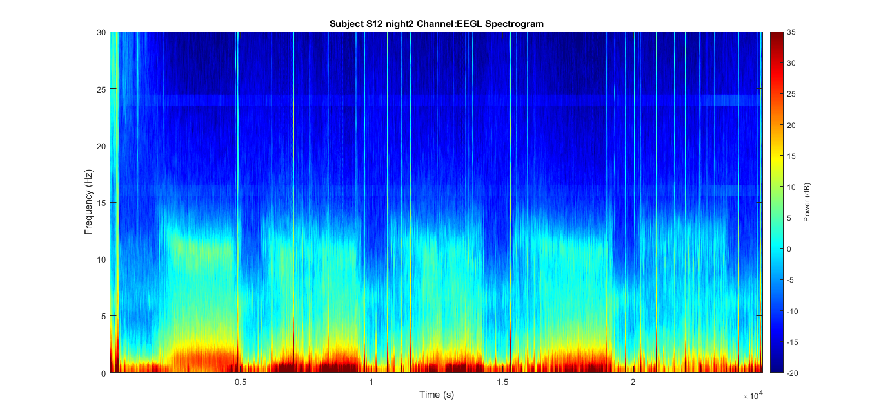
Data - spectrogram
Subject : Raw, S12, night2, FP1
Notes:
Sleep EEG Multitaper Spectrogram
http://prerau.bwh.harvard.edu/resources/
Video Tutorials:
Multitaper Spectral Analysis Code in Matlab https://www.youtube.com/watch?v=jjEjkXLLDJU
Tutorial Part 3 https://www.youtube.com/watch?v=g_MkonANaWk&t=46s
(EEG is not stationary hence the Fourier Transform at a finite length of sequence may be not a good idea. There will be some discontinuities at the edge of the EEG data. Then, we have short time Fourier Transform, to analyze the signal with taper and also overlap to reduce the losses due to the taper. )
Time-Frequency analysis of
biophysical time series https://sccn.ucsd.edu/eeglab/workshop06/handout/TP_Jung_Workshop_Time_Frequency_Analysis.pdf

Slide 22
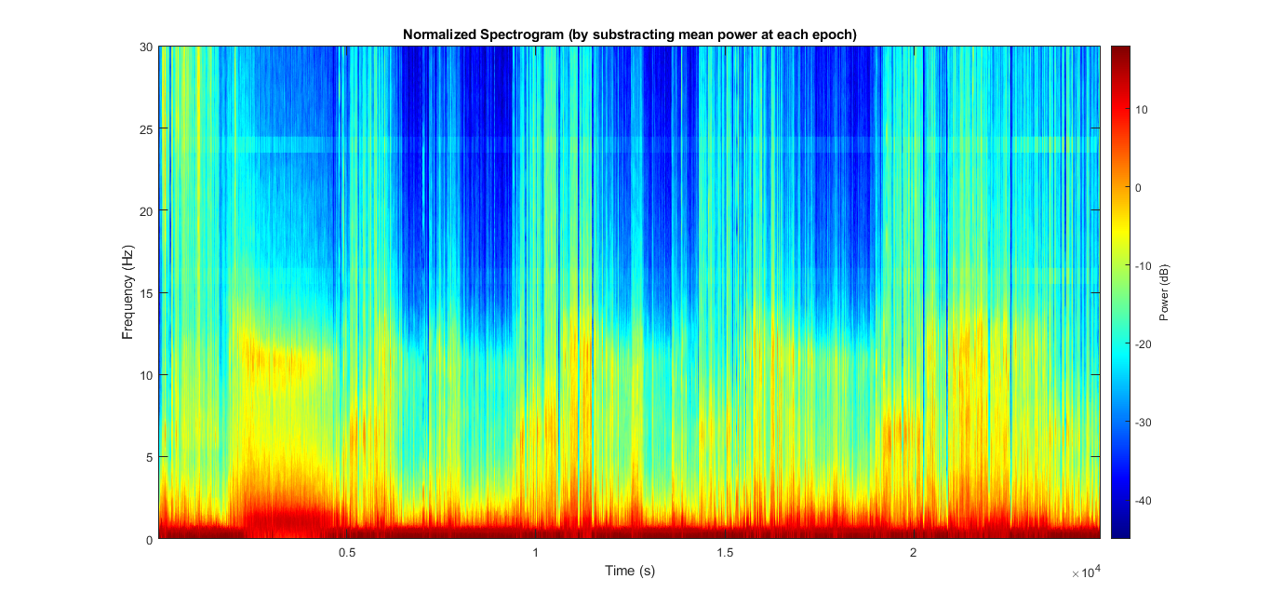
Data - normalized spectrogram
Subject : Raw, S12, night2, FP1
Notes:
normalized_power = repmat(mean(power,2), [1 size(power,2)]);
imagesc(stimes, sfreqs, (pow2db(power) - pow2db(normalized_power))')
At each epoch, there is a mean frequency.
The normalized power is obtained by subtracting the mean frequency at this epoch from the frequencies at this epoch.

Slide 23
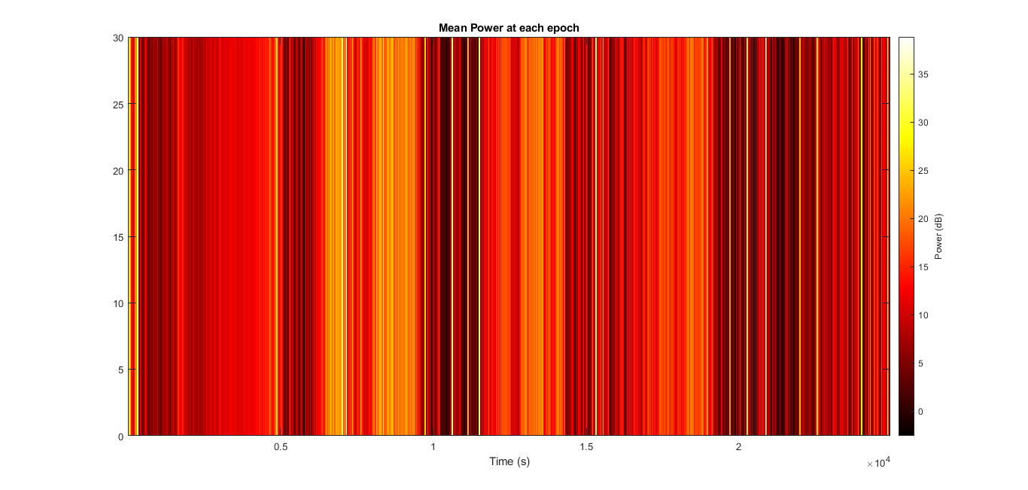
Data - mean power
Subject : Raw, S12, night2, FP1
Notes:
normalized_power = repmat(mean(power,2), [1 size(power,2)]);
imagesc(stimes, sfreqs, (pow2db(power) - pow2db(normalized_power))')
At each epoch, there is a mean frequency.
The normalized power is obtained by subtracting the mean frequency at this epoch from the frequencies at this epoch.

Slide 24
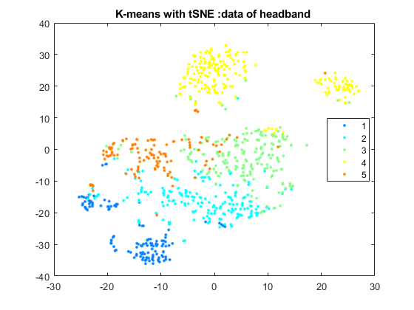
K-medoids Clustering Results
Subject : Raw, S12, night2, FP1
K-medoids Clustering
Try to use catch22 to divide the epochs into five clusters.
Cosine distance
Subject : S12, night2, FP1
Notes:
t-SNE (instead of PCA)
K-means (cosine distance)

Slide 25
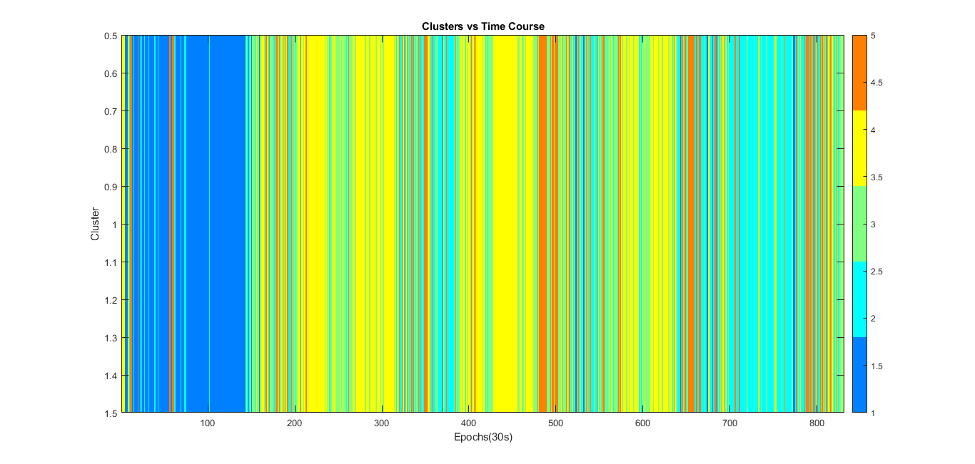
5-medoids Clustering Results - Time Course
Subject : Raw, S12, night2, FP1

Slide 26
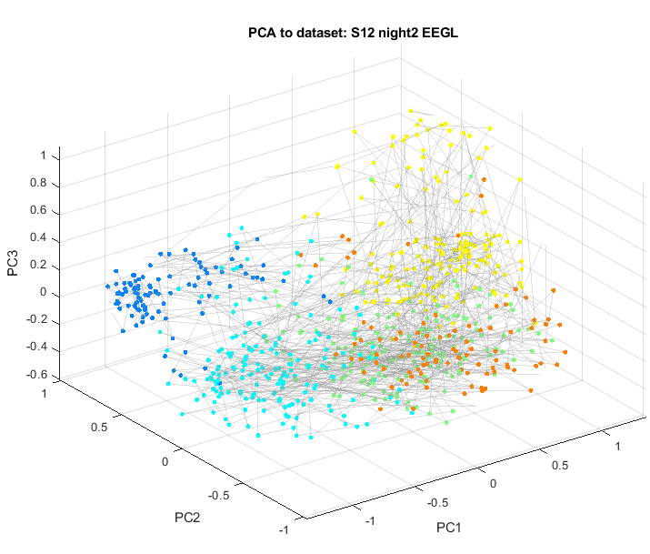
PCA - whole night
Subject : Raw, S12, night2, FP1

Slide 27
Sleep Periods
Subject : Raw, S12, night2, FP1
Assume there are three subset of epochs
Sleep onset: 100 ~ 200th epochs
Middle: 400 ~ 500th epochs
Near wake: 700 ~ 800th epochs
Apply an independent PCA to each sleep period.

Slide 28
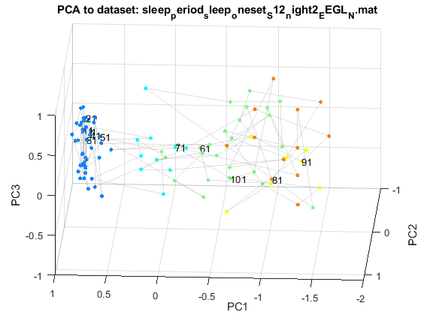
Sleep Periods - Sleep Onset
Subject : Raw, S12, night2, FP1
Sleep onset: 100 ~ 200th epochs

Slide 29
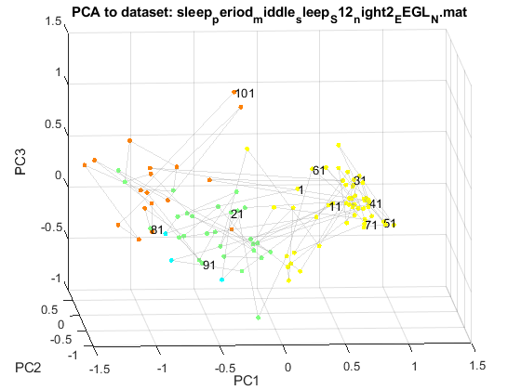
Sleep Periods - In the Middle
Subject : Raw, S12, night2, FP1
Middle: 400 ~ 500th epochs

Slide 30
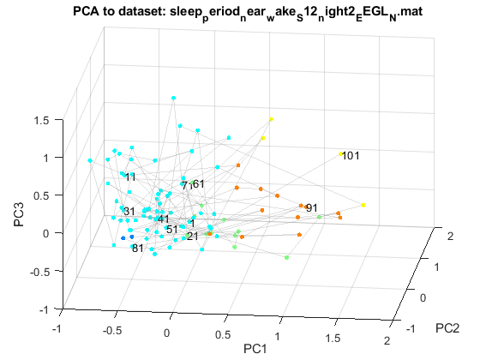
Sleep Periods - Near Wake
Subject : Raw, S12, night2, FP1
Near wake: 700 ~ 800th epochs

Slide 31
Pre-processed Data
With band-pass filter (0.1 ~ 40 Hz)
Dataset: 2 subjects, 2 nights, 2 channels

Slide 32
TODO: Correlation before and after pre-processing

Slide 33
Appendix
Other analysis

